Slide 1
PIZZA SALES ANALYSIS USING SQL
By
MEGHA KIRAN

Slide 2
INTRODUCTION
Hello Everyone!
My name is Megha Kiran.I am excited to present my SQL data analysis project on Pizza Sales.In
this project I have utilized SQL to gain valuable insights from sales data. By leveraging SQL queries,
we'll delve into various aspects such as sales performance,top selling pizzas,order patterns,
and customer demographics.

Slide 3
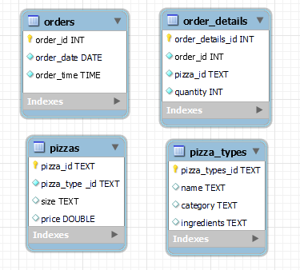
SCHEMA

Slide 4
QUESTIONS TO BE ANSWERED
Basic Level:
1.Retrieve the total number of orders placed.
2.Calculate the total revenue generated from pizza sales.
3.Identify the highest-priced pizza.
4.Identify the most common pizza size ordered.
5.List the top 5 most ordered pizza types along with their quantities.
Intermediate Level:
6.Join the necessary tables to find the total quantity of each pizza category ordered.
7.Determine the distribution of orders by hour of the day.
8.Join relevant tables to find the category-wise distribution of pizzas.
9.Group the orders by date and calculate the average number of pizzas ordered per day.
10.Determine the top 3 most ordered pizza types based on revenue.
Advanced Level:
11.Calculate the percentage contribution of each pizza type to total revenue.
12.Analyze the cumulative revenue generated over time.
13.Determine the top 3 most ordered pizza types based on revenue for each pizza category.

Slide 5

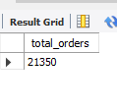
Q1.Retrieve the total number of orders placed.

Slide 6
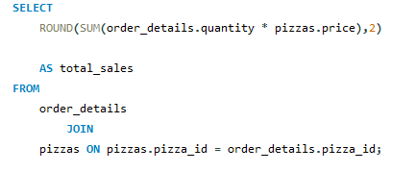
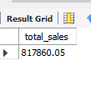
Q2.Calculate the total revenue generated from pizza sales.

Slide 7
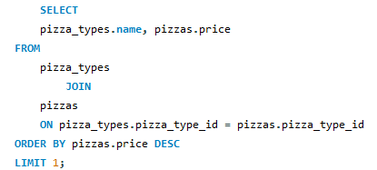
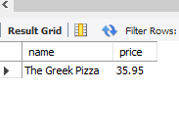
Q3.Identify the highest-priced pizza.

Slide 8
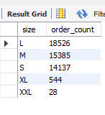
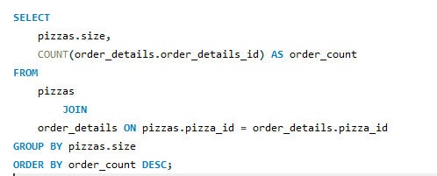
Q4.Identify the most common pizza size ordered.

Slide 9
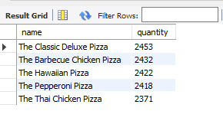
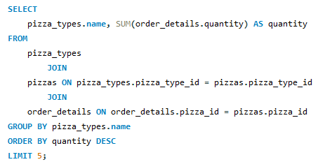
Q5.List the top 5 most ordered pizza types along with their quantities.

Slide 10
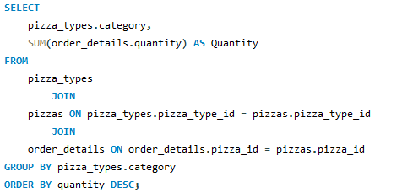
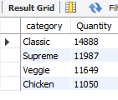
Q6.Join the necessary tables to find the total quantity of each pizza category ordered

Slide 11
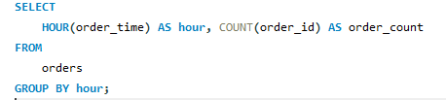
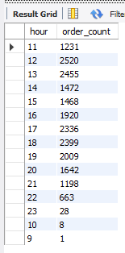
Q7.Determine the distribution of orders by hour of the day.

Slide 12
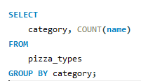
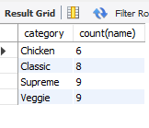
Q8.Join relevant tables to find the category-wise distribution of pizzas.

Slide 13
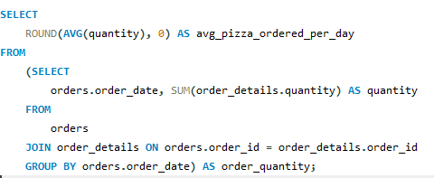
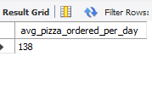
Q9.Group the orders by date and calculate the average number of pizzas ordered per day.

Slide 14
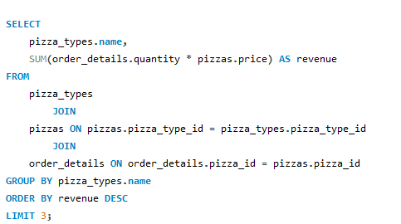
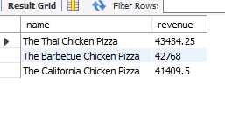
Q10.Determine the top 3 most ordered pizza types based on revenue.

Slide 15
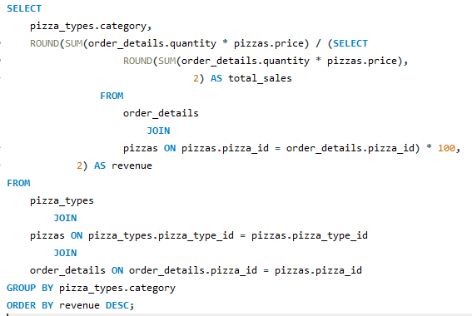
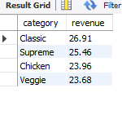
Q11.Calculate the percentage contribution of each pizza type to total revenue

Slide 16
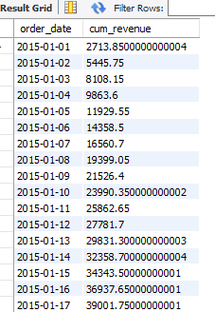
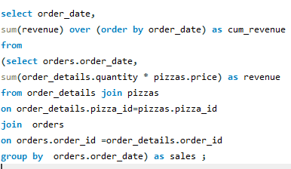
Q12.Analyze the cumulative revenue generated over time.

Slide 17
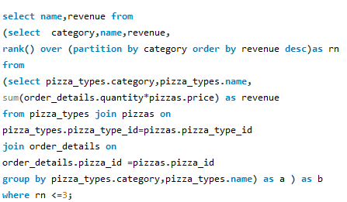
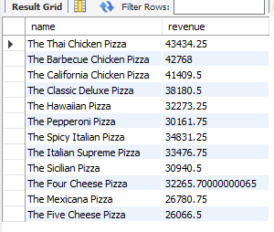
Q13.Determine the top 3 most ordered pizza types based on revenue for each pizza category.

Slide 18
CONCLUSION
Key Takeaways:
High Order Volume and Revenue: With a substantial total number of orders placed and significant revenue generated, the business demonstrates a strong market presence and customer demand for our pizzas.
Popular Pizzas and Sizes: Identifying the most ordered pizza types and preferred sizes helps us understand customer preferences better, allowing us to optimize our menu and inventory accordingly.
Peak Ordering Times: The distribution of orders by hour highlights peak times, which can guide staffing and resource allocation to ensure efficient service during busy periods.
Revenue Drivers: Understanding which pizzas contribute the most to our revenue enables us to focus on promoting and enhancing these high-performing items.
Category Insights: The analysis of pizza categories and their respective performance aids in refining our product offerings and marketing strategies to better cater to customer demands.
Daily Sales Trends: Monitoring the average number of pizzas ordered per day and cumulative revenue time provides a clear picture of our sales trends and business growth, helping in forecasting and planning.

Slide 19
THANK YOU

